Slide 1
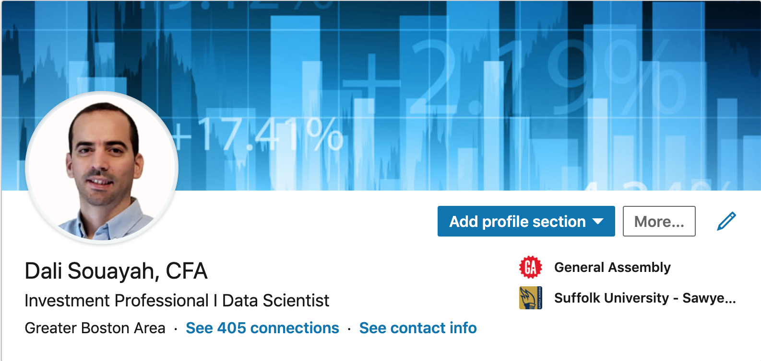




Notes:
Hello… Thank you all for making the time to attend today.
My name is Dali Souayah... I am an investment professional by background.
I have an MBA from Suffolk University. I am also a CFA charterholder.
I spent the last 10 years of my career in the Middle East working in the Private Equity sector.
Last September I moved back to Boston and thought of a career/focus change... I was becoming increasingly convinced that the job of an investment analyst will sooner rather than later become obsolete if not supplemented with big data analysis tools and machine learning skills. And that’s why I signed up for this immersive course at GA.
So, welcome and I will take the next 7 minutes or so to give you a glimpse of my capstone project, which I titled Machine trading.

Slide 2

Machine Trading
Capstone Project
Dali Souayah
5-29-2019

Slide 3
Data Science Process
1. Problem Definition
2. Data Collection and Processing
4. Model Selection
5. Model Evaluation
6. Future Work
Notes:
In this presentation:
I will start by exposing the problem and how I will go about solving it
I will then briefly describe the data collection and cleaning process
Once done, I will talk about the different models I used
And will then evaluate my best model through a comparison of its returns with that of a market proxy
Finally, I will conclude with future work that i deem necessary for a real life implementation of the model

Slide 4
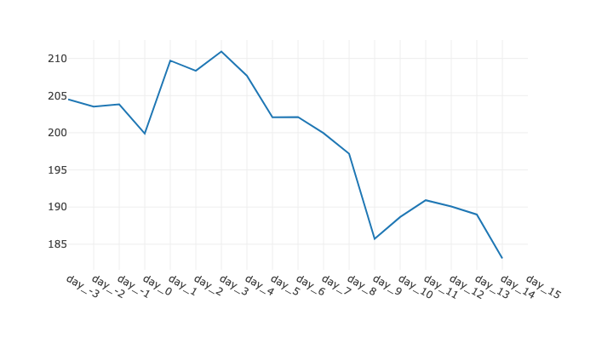

Real World Problem
Apr 30, 2019: AAPL 199.90
Press Release Financial Results Q2
Notes:
This is a chart of apple’s stock price right after its last earning release.
These ups and downs following an earning’s release is by no means an exception but rather the rule

Slide 5
Real World Problem
Apr 30, 2019: AAPL 199.90
😀
😰
😡
Press Release Financial Results Q2
Notes:
Looking closer at the chart, we notice that the stock price went up by about 5% within 3 days of the earning’s release then conceded 10% within a matter of 5 days or so.
So, Imagine a tool that tells you to sell at the high point and buy at the low point. That would make you very rich. :)
In financial lingo this is called market timing, and as far as the financial theory of market efficiency is concerned no body can time or beat the market, at least not in a consistent way over a long enough period of time.
Well i understand why it is difficult for a financial analyst to predict this movement of the stock price. Financial analysts are trained to analyze economic fundamentals. But this is hardly one. Fundamentals do not change this drastically, this frequently.
My hypothesis is that this type of movement is due to over-reaction driven by emotions. And the edge that Data scientists have over financial analysts is that they have the tools to analyze emotions.

Slide 6
Data Science tools
Natural Language Processing
Analyze the text of the 8-k SEC filings
Focus on qualifiers that echo, negativity, positivity or uncertainty
Train a model to learn the trend between what is said and the movement of the stock price
Notes:
And the tool is Natural Language processing, which I’ll use to analyze the text contained in the earning releases known as the 8-K SEC filings.
My focus will be on specific words with either negative, positive, or uncertain connotation
And I will train a model that would predict the direction of the stock price based on the existence and the frequency of these words.

Slide 7
Data Collection
SEC Edgar website
Dictionary of words
Yahoo Finance website
Notes:
I used 3 main sources to collect my data:
For the earnings releases, which is my main predictor, I scraped the SEC Edgar website
I also used a dictionary of financial sentiment words to extract relevant words from the earnings releases
For the Stock price changes, which is the variable that i am trying to predict, I scraped stock price data from Yahoo finance
I also tested correlation with other variables, mainly analysts’ price targets and stock ratings which I obtained from bloomberg, but no correlation was to be found. At which point I needed to remind myself that I am analyzing irrational behaviour, so even though we think that some data should have a correlation, it’s not necessarily the case

Slide 8
Model selection
Naive Bayes and Support Vector Machine consistently beat the baseline prediction
Baseline prediction: 58.9%
NB accuracy score: 68.5%
SVM accuracy score: 66.6%
Notes:
Now in terms of model selection, I tested several algorithms and the ones that stood out are the Naive Bayes and the support vector machine models. They have consistently outperformed the baseline prediction of 58%.
The Naive Bayes model by a margin of 10% and the SVM by a margin of 8%, yielding an accuracy score of 68% and 66%, respectively
And it is of little surprise, because they are both well suited for high dimensional data such as text data

Slide 9
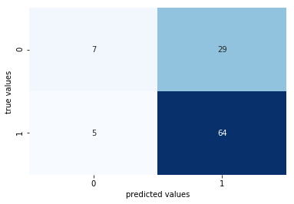
Model Evaluation
Predicted almost all instances of the price going up
Not predicting enough of prices going further down
down
up
down
up
Notes:
This confusion matrix provides a more detailed view on where the model did well and where it lagged
The model did well when it came to recognizing negative over-reactions and issuing a buy recommendation to correct for that over-reaction. It was correct 92% of the time.
The model however, did not do well when it came to recognizing instances where the stock went further down. It only recognized 20% of those instances
Now an element of explanation is that the average investor is risk averse which means that s/he tends to react/trade more on fear/negative news than on positive news. So instances of negative overreactions constituted the majority of the cases and the model was better trained on those instances.

Slide 10
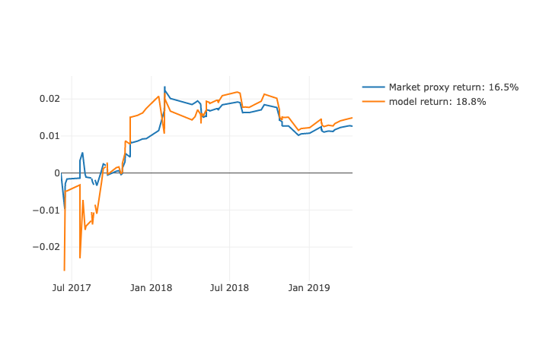
Simulation
The model out-performed passive investment by 2%
0.30
0.15
0
-0.15
-0.30
Notes:
And this is a simulation of how my model fared against a passive investment strategy, which i am taking as the market proxy
The model outperformed an average of 2% in annualized return over a 2 year period
Now 2% is much less than the 8% or 10% surplus in accuracy rate the model was supposed to provide. I found out that the model was more accurate when it mattered less in terms of dollar returns.
And that’s the reason I am not a millionaire yet. :)
Which leads me to the last slide about future improvement

Slide 11
Future Improvements
Multi-classification and Regression models
Introduce transaction fees
Cover more stocks and different industries
Use other text sources (e.g. social media)
Notes:
Several things:
The model is too simple, in fact... it was constructed as a binary classification model. So it issues the same recommendation to buy or sell regardless of the strength of the prediction. And that’s a source of loss in performance.
As a mitigation to that I am working, as a first step, on making the model a multi-classification. So the model will not just issue a buy or sell but also a strong buy and strong sell recommendation as well as a hold recommendation in instances where the transaction outweigh the expected returns.
the model does not account yet for any transaction fees, which if applied would have wiped out any extra returns.
As a further improvement I would consider making it a regression model whereby the model will not only predict the direction but also a precise order of magnitude of that direction.
The model will certainly gain in accuracy if I increased the number of observations to train the model in instances of under-reactions as well as over-reactions.
Also expand the analysis to other sectors in addition to the tech sector which was the main focus of this project
And finally, analyzing other text sources such as news and social media. I expect there is a lot of financial sentiment insight to train my model on there as well.

Slide 12




Thank you
For your attention

